Slide 1
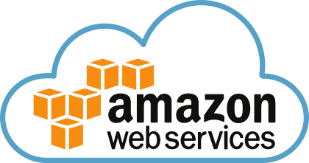
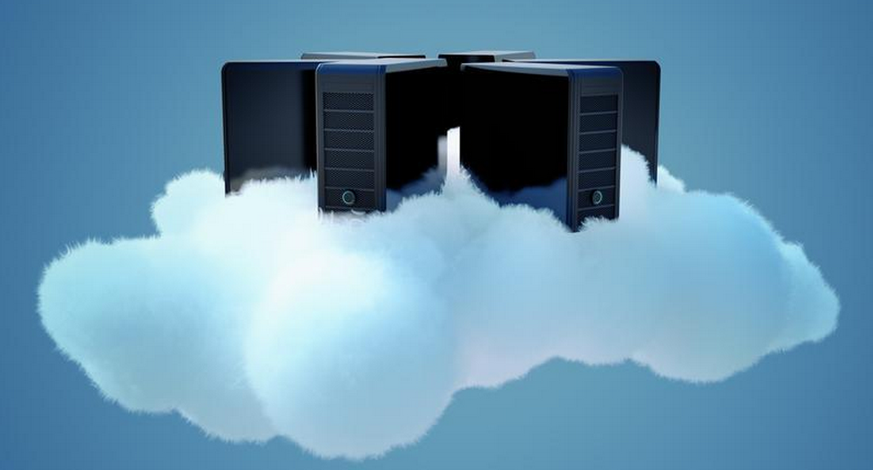

AWS Training - Session 10
Dr. Prabhakar PhD
Senior Integration Engineer
Decision Minds, Bengaluru.

Slide 2
Contents
Amazon DynamoDB
AWS White Papers
Well-Architected Framework
Cost Optimization Pillar
Operational Excellence Pillar
Performance Efficiency Pillar
Reliability Pillar
Security Pillar
Cloud Best Practices
Services for AWS Solution Architect Associate Exam
Amazon S3
Amazon Glacier
Amazon EC2
Amazon EBS
Amazon VPC
Elastic Load Balancing
Amazon CloudWatch
Auto Scaling
Amazon IAM
Amazon RDS
Amazon Redshift
Amazon DynamoDB
Amazon SQS
Amazon SWF
Amazon SNS
Amazon Route53
Amazon ElasticCache

Slide 3
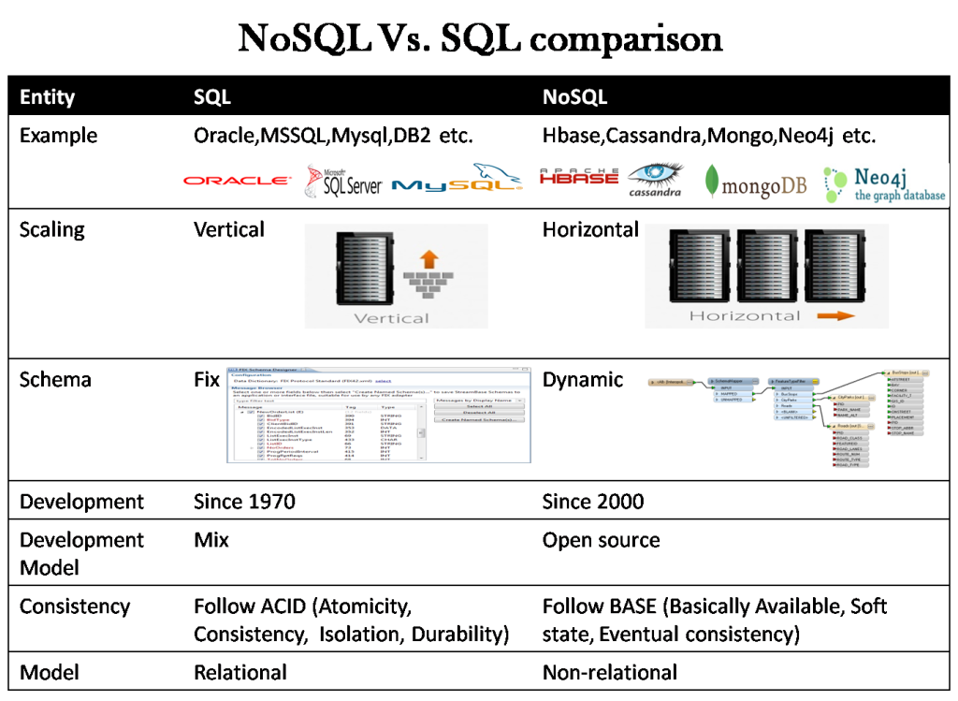

Slide 4
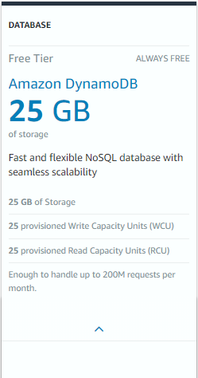
Amazon DynamoDB Free Tier

Slide 5
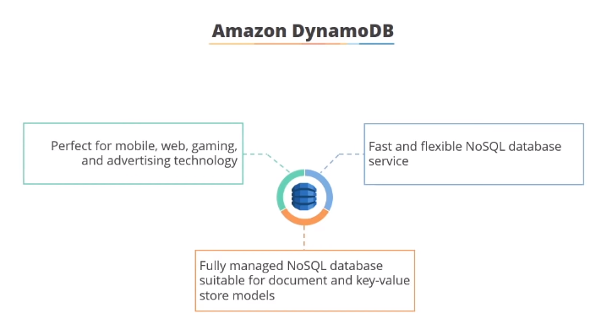

Slide 6
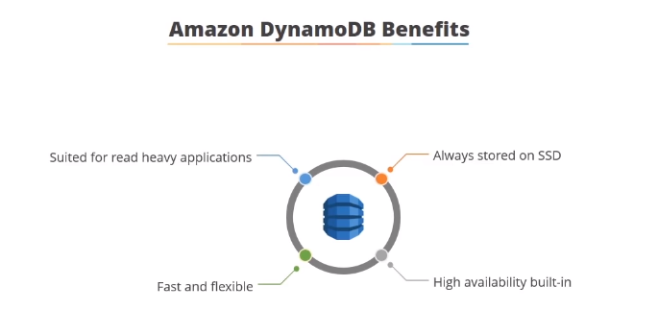

Slide 7
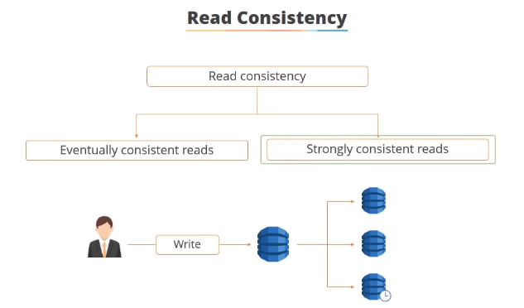
DynamoDB uses eventually consistent and strongly consistent reads to support dynamic application needs. Eventually consistent reads do not always deliver current data. The strongly consistent reads always deliver current data

Slide 8
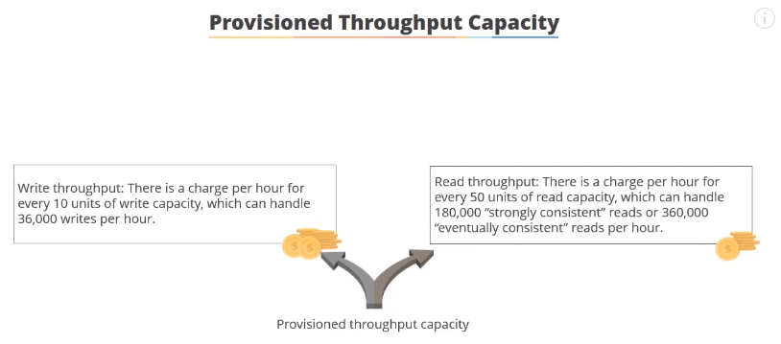
In table creation, you specify provisioned throughput, which reserves resources for reads and writes. You use capacity units to measure and set throughput. When applications exceed the set throughput, requests fail.

Slide 9
Advantages
The two main advantages of DynamoDB are scalability and flexibility. It does not force the use of a particular data source and structure, allowing users to work with virtually anything, but in a uniform way.
Its design also supports a wide range of use from lighter tasks and operations to demanding enterprise functionality. It also allows simple use of multiple languages: Ruby, Java, Python, C#, Erlang, PHP, and Perl.

Slide 10
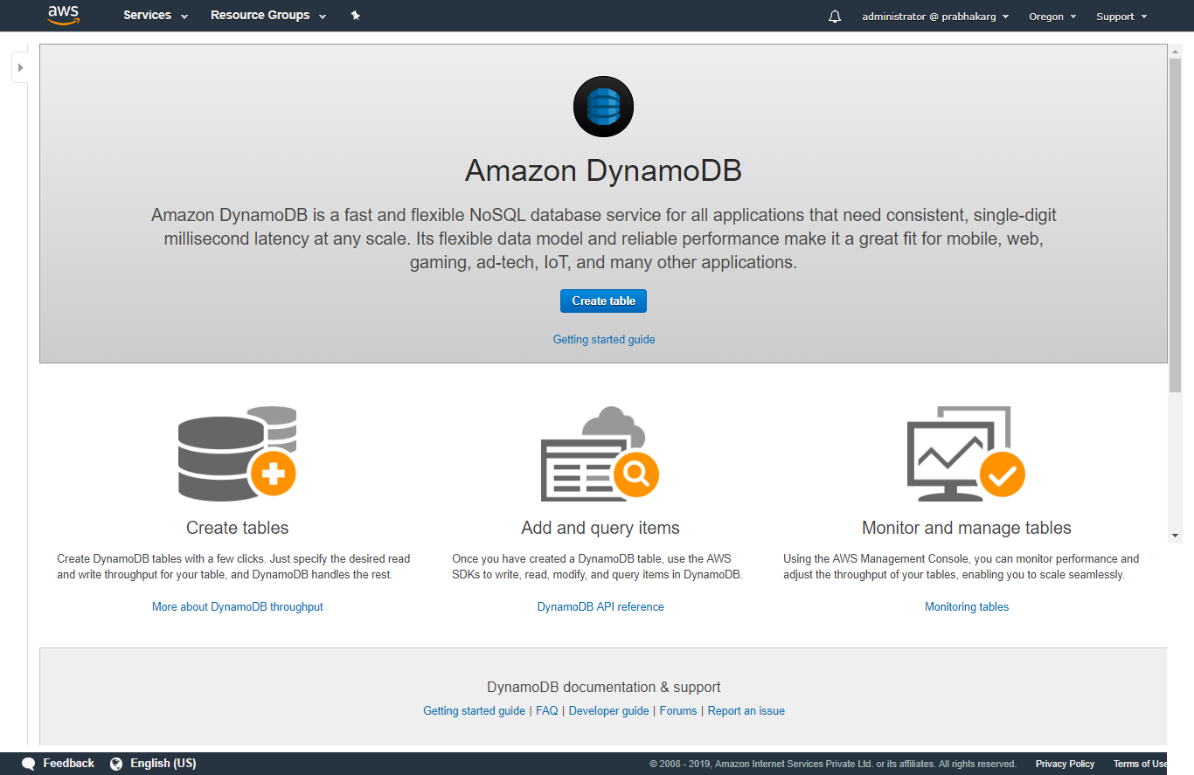

Slide 11
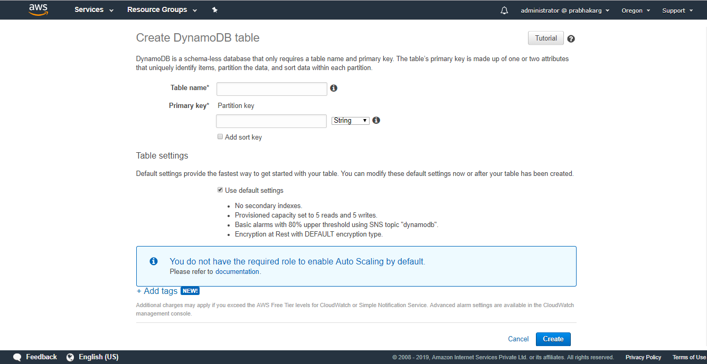
The Primary Keys serve as the means of unique identification for table items, and secondary indexes provide query flexibility. DynamoDB streams record events by modifying the table data.

Slide 12
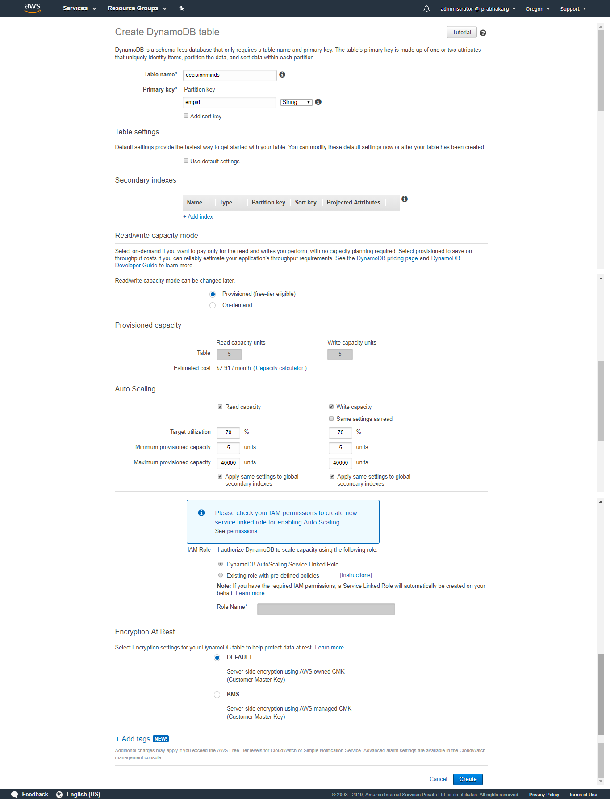

Slide 13
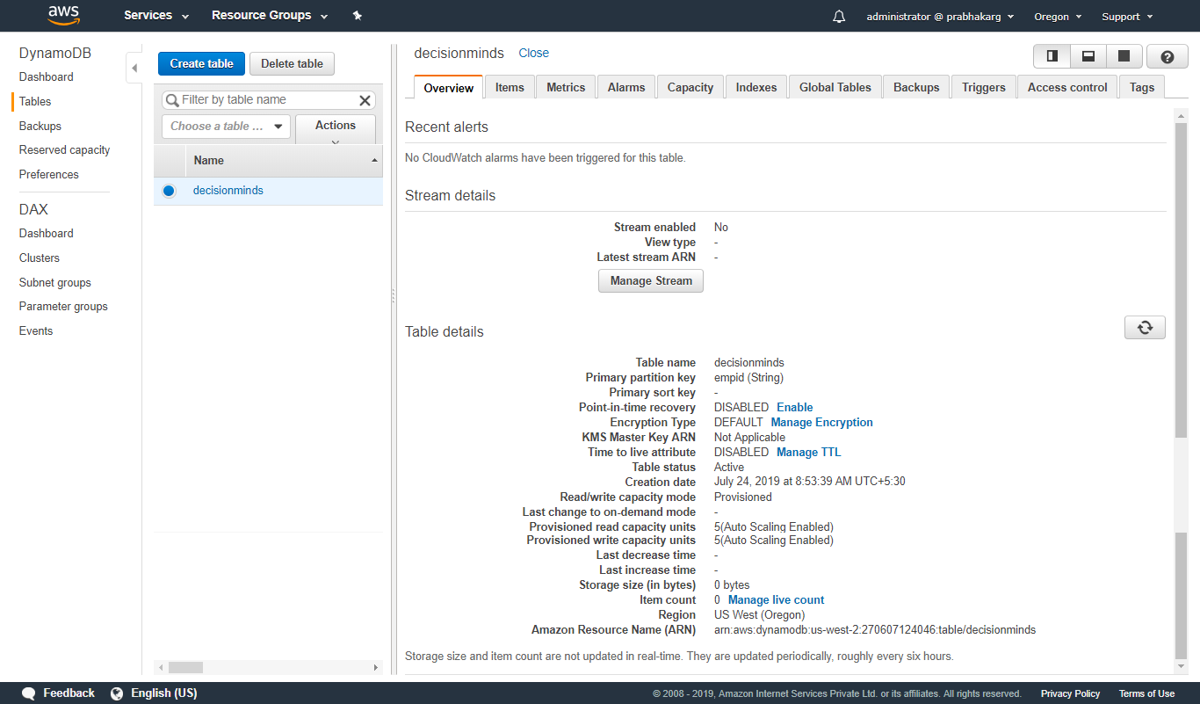

Slide 14
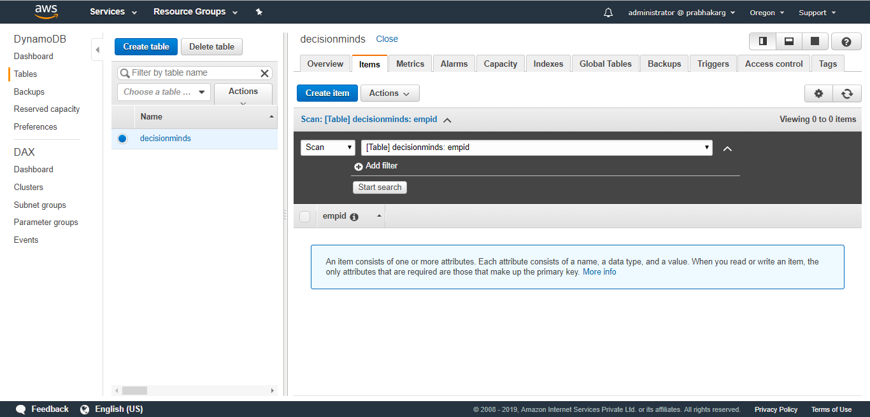

Slide 15
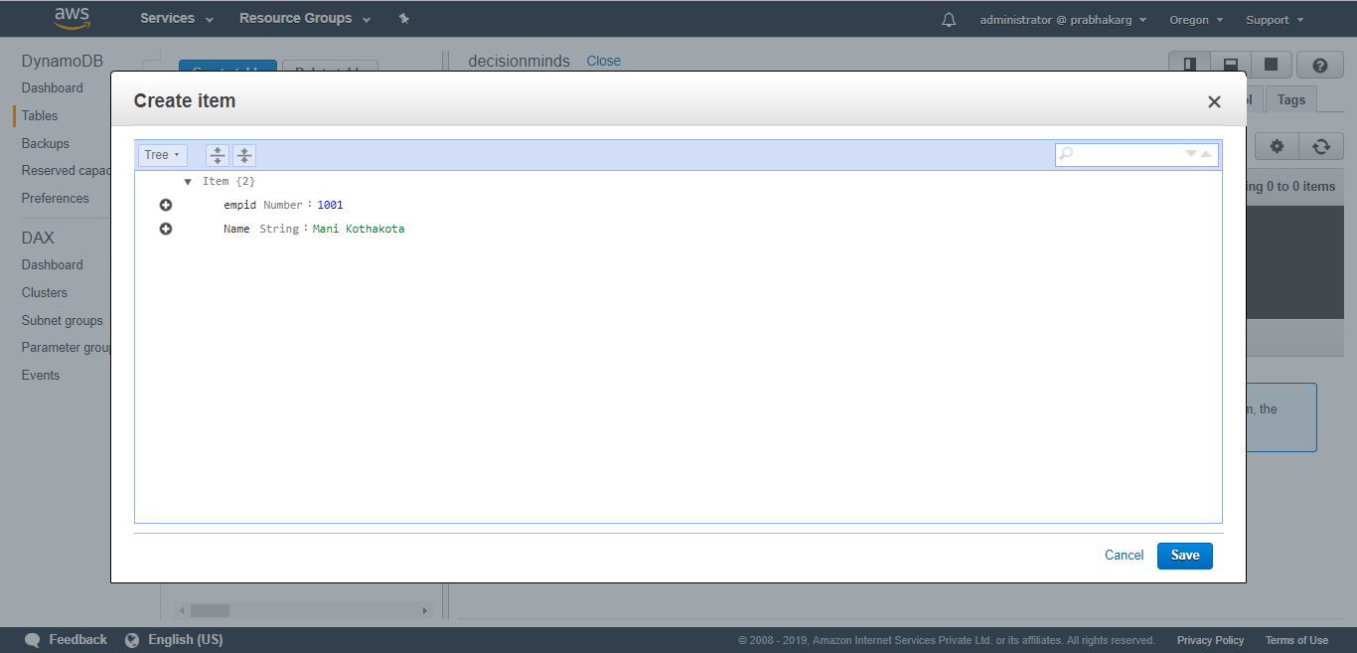

Slide 16
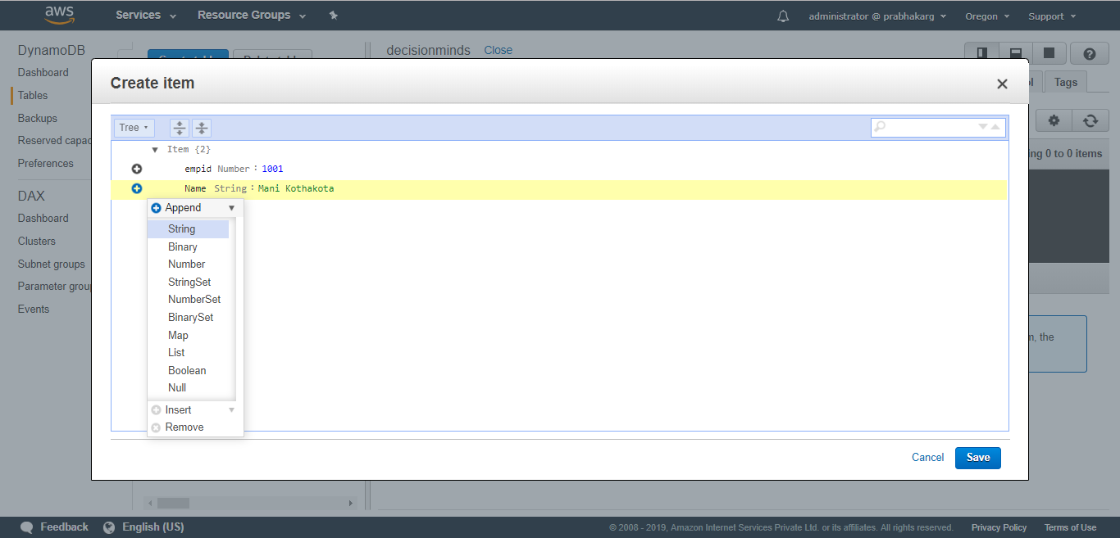

Slide 17
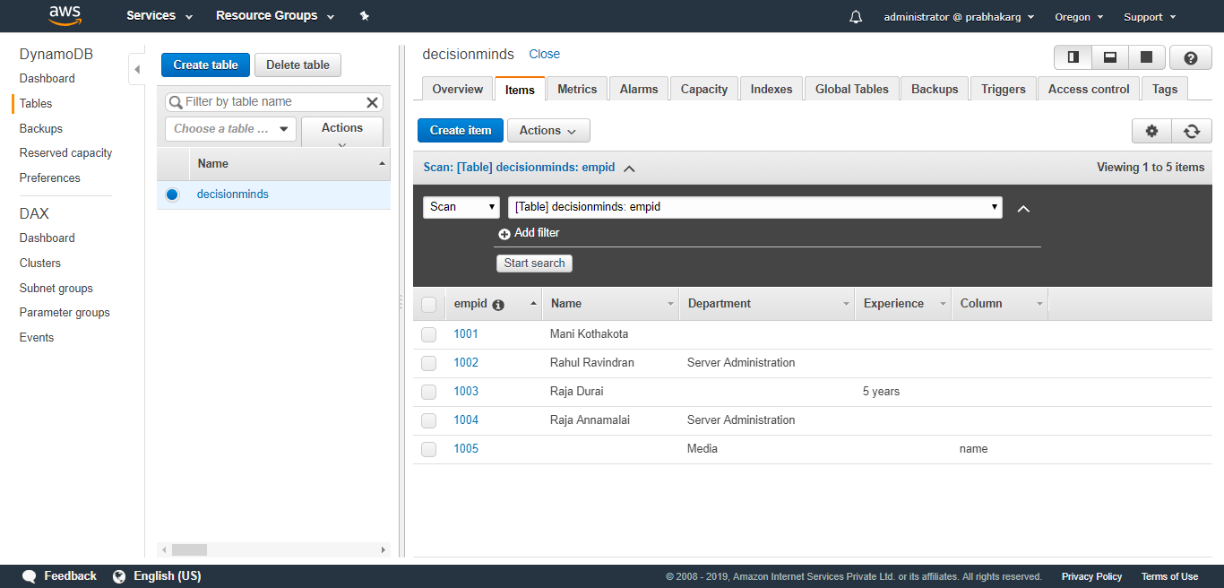

Slide 18
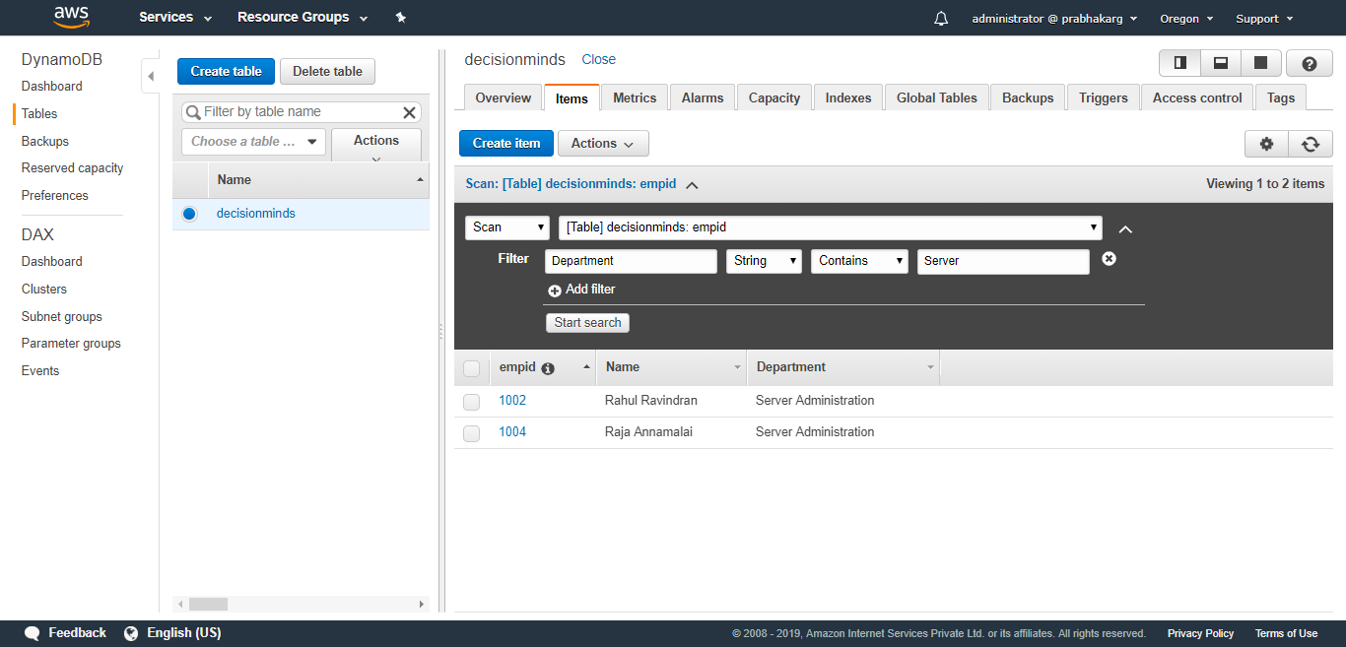

Slide 19
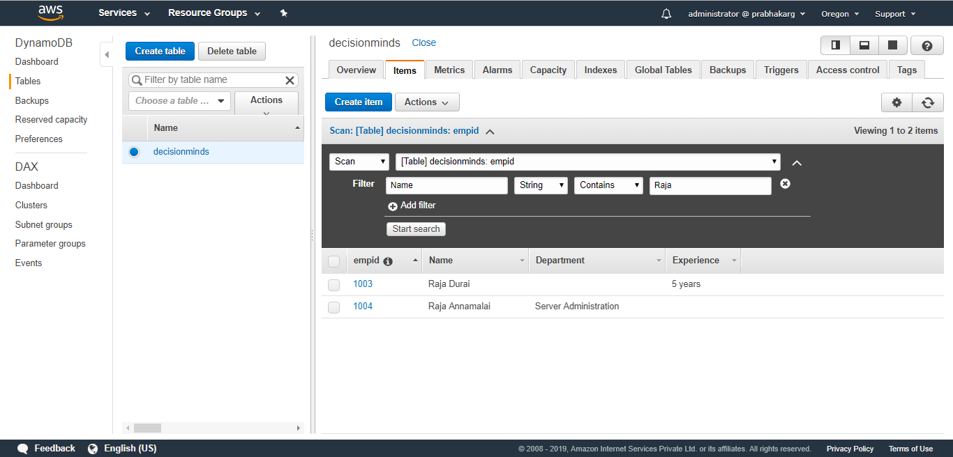

Slide 20

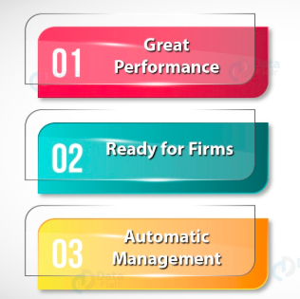
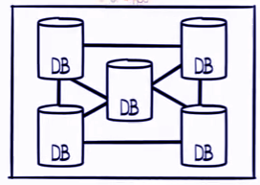
Amazon DynamoDB delivers the consistent and quick response at any scale. The apps are also built with virtually unlimited throughput and storage. A feature of in-memory cache is provided to reduce response time from millisecond to microsecond, without any app changes.
The data stored in the Amazon DynamoDB is secured with encryption and provides reliability with service level agreement. Amazon Management tools are also provided to monitor the tables, integrated monitoring tools, and support for private connections over VPN.
AWS DynamoDB continuously backs up the data for the safety purpose and automatically scales the throughput up or down. DynamoDB replicates the table which helps to access data by the globally distributed application very quickly.

Slide 21
Uses of Amazon DynamoDB
Used to build powerful web applications that automatically scales up and down. AWS DynamoDB also reduces the workload to maintain servers.
Amazon DynamoDB is used to build the mobile app which is personalized for the smooth experience. It focuses on the operational tasks so that the user can focus on different applications.
Devices can connect to the high-velocity, high-volume Internet of things data in Dynamo DB to Amazon Redshift and Amazon Quicksight.
The user can create bidding platforms and recommendation engines with the scalability, throughput, and availability of DynamoDB.
Flexible and reusable micro-services using AWS DynamoDB can build and for the fast performance.

Slide 22
White Papers: Cost Optimization Pillar
AWS Well Architected framework is based on five pillars:
Operational Excellence
Security
Reliability
Performance Efficiency
Cost Optimization
Cost optimization pillar focuses on how to architect systems with the most effective use of services and resources, to achieve business outcomes at a minimal cost.

Slide 23
White Papers: Cost Optimization Pillar
Cost optimization can be challenging in traditional on-premises solutions because you have to predict future capacity and business needs
By adopting the practices in this paper, you’ll be able to build architectures in which you can do the following:
Ensure that your usage and costs move in line with demand.
Use appropriate services and resource types to minimize costs.
Analyse and attribute costs.
Reduce costs over time.
Cost optimization is a continual process of refinement and improvement of a system over its entire lifecycle. From
A cost-optimized system will fully utilize all resources, achieve an outcome at the lowest possible price point, and meet your functional requirements.

Slide 24
White Papers: Cost Optimization Pillar
Design Principles
Adopt a consumption model:
Pay only for the computing resources you consume, and increase or decrease usage depending on business requirements—not with elaborate forecasting.
Analyze and attribute expenditure:
The cloud makes it easier to accurately identify the usage and cost of systems, which then allows transparent attribution of IT costs to revenue streams and individual business owners.
Measure overall efficiency:
Measure the business output of the system and the costs associated with delivering it.
Use managed services to reduce cost of ownership:
In the cloud, managed services remove the operational burden of maintaining servers for tasks like sending email or managing databases.
Stop spending money on data center operations:
AWS does the heavy lifting of racking, stacking, and powering servers, so you can focus on your customers and business projects rather than on IT infrastructure.

Slide 25
White Papers: Cost Optimization Pillar
Cost optimization in the cloud is composed of four areas:
Cost-effective resources
Matching supply with demand
Expenditure awareness
Optimizing over time
In some cases, it’s best to optimize for speed—going to market quickly, shipping new features, or simply meeting a deadline—rather than investing in up-front cost optimization.

Slide 26
White Papers: Cost Optimization Pillar
Cost-Effective Resources
Using the appropriate services, resources, and configurations for your workloads is key to cost savings. In AWS there are a number of different approaches:
Appropriate provisioning
Right sizing
Purchasing options: On Demand Instances, Spot Instances, and Reserved Instances
Geographic selection
Managed services
Optimize data transfer

Slide 27
White Papers: Cost Optimization Pillar
Appropriately Provisioned
Managed services have attributes that can be set to ensure sufficient capacity to meet your needs. Set and monitor these attributes so that your excess capacity is kept to a minimum and performance is maximized for end users.
Modify the attributes of AWS managed services using the AWS Management Console or AWS APIs and SDKs to align resource needs with changing demand.
When provisioning systems on managed services understand the requirements of adjusting the service capacity. These requirements are typically time, effort, and any impact to normal system operation. If the time to adjust is longer than you want, consider over-provisioning just a bit to allow for growth.

Slide 28
White Papers: Cost Optimization Pillar
Right Sizing
Right sizing is using the lowest cost resource that still meets the technical specifications of a specific workload. You can right size iteratively by adjusting the size of resources to optimize for costs.
AWS provides APIs, SDKs, and features that allow resources to be modified as demands change. For example, on Amazon Elastic Compute Cloud (Amazon EC2) a stop-and-start can be performed to allow a change of instance size or instance type.
Monitor resources and alarms to provide the data for right sizing. This monitoring can also provide triggers for the next right-sizing cycle. Analysis of resources can be performed using CloudWatch and Amazon CloudWatch Logs can be captured and utilized to perform right-sizing analysis.

Slide 29
White Papers: Cost Optimization Pillar
Key considerations when you perform right-sizing exercises
The monitoring must accurately reflect the end-user experience.
Select the correct granularity for the time period of analysis that is required to cover any system cycles.
Assess the cost of modification against the benefit of right sizing.

Slide 30
White Papers: Cost Optimization Pillar
Purchasing Options
On demand
You pay a flat hourly rate, and you have no long-term commitments. You can increase or decrease the capacity of your resources or services based on the demands of your application. You only pay the specified hourly rate for your usage.
Spot Instances
Spot Instances allow you to use spare compute capacity at a significantly lower cost than On-Demand EC2 instances (up to 90%). You can also launch Spot Instances with a required duration (Spot blocks, from 1 to 6 hours), which are not interrupted due to changes in the Spot price. Spot Instances are ideal for use cases such as batch processing, scientific research, image or video processing, financial analysis, and testing.
The maximum price you could pay is the on-demand price. When your maximum price meets or exceeds the current Spot price, your request is fulfilled and your instances will run until you choose to terminate them. If the current Spot price rises above your maximum price, the instance can be gracefully stopped or placed into hibernation, and the capacity is reclaimed by AWS. When the current price falls back below your maximum and capacity is available, the instances will be resumed from their prior state to resume their work.
If your instance is due to be reclaimed you will receive a two-minute warning (EC2 Spot Instance Termination Notice). Your application can use this time to save its state, upload final log files, or remove itself from a load balancer.

Slide 31
White Papers: Cost Optimization Pillar
Purchasing Options
Reserved Instances/Capacity
AWS provides a number of ways for you to reduce your costs by reserving or committing to use a certain amount of resources. With Reserved Instances, you commit to a period of usage (one or three years) and save up to 75% over equivalent On-Demand hourly rates.
There are two types of Amazon EC2 Reserved Instances:
Standard
Convertible
There are three payment options for Reserved Instances:
• No up-front payment – There is no up-front payment; you then pay a reduced hourly rate each month for the total hours in the month.
• Partial up-front payment – Part of the usage is paid up front; you then pay a reduced hourly rate each month for the total hours in the month.
• Full up-front payment – Usage for the entire period is paid up front, and no other costs are incurred for the remainder of the term regardless of the number of hours used.
EC2 Fleet
EC2 Fleet allows you to define a target compute capacity, and then specify the instance types and the balance of On-Demand, Reserved, and Spot for the fleet. EC2 Fleet will then automatically launch the lowest price combination of resources to meet the defined capacity.

Slide 32
White Papers: Cost Optimization Pillar
Geographic Selection
Reduced latency can be a key factor in improving usage of your e-commerce or other websites. When you architect your solutions, a best practice is to seek to place computing resources closer to users to provide lower latency and strong data sovereignty.
The AWS Cloud infrastructure is built around Regions and Availability Zones. A Region is a physical location in the world where we have multiple Availability Zones. Availability Zones consist of one or more discrete data centers, each with redundant power, networking, and connectivity, housed in separate facilities.
Using the AWS Simple Monthly Calculator you can estimate the cost to architect your solution in various Regions around the world and compare the cost of each.

Slide 33
White Papers: Cost Optimization Pillar
Managed Services
AWS managed services remove the burden of undifferentiated heavy lifting required to maintain a service, which allows you to focus on innovating rather than keeping the lights on. By using these managed services, you can reduce or remove much of your administrative and operational overhead, freeing you to work on value-adding activities.
AWS provides managed services for databases, such as Amazon RDS and Amazon DynamoDB. You can also use serverless or application-level services such as AWS Lambda, Amazon Simple Queue Service (Amazon SQS), Amazon Simple Notification Service (Amazon SNS), and Amazon Simple Email Service (Amazon SES).
The key AWS services that support a managed approach are AWS database and analytics services, such as Amazon RDS, Amazon DynamoDB, Amazon Elasticsearch Service, and Amazon EMR

Slide 34
White Papers: Cost Optimization Pillar
Optimize Data Transfer
Architecting for data transfer ensures that you minimize data transfer costs. This may involve using content delivery networks to locate data closer to users, or using dedicated network links from your premises to AWS.
Amazon CloudFront is a global content delivery network that delivers data with low latency and high transfer speeds. It caches data at edge locations across the world, which reduces the load on your resources. By using CloudFront, you can reduce the administrative effort in delivering content to large numbers of users globally, with minimum latency.
AWS Direct Connect allows you to establish a dedicated network connection from your premises to AWS. This can reduce network costs, increase bandwidth, and provide a more consistent network experience than internet-based connections.

Slide 35
White Papers: Cost Optimization Pillar
Matching Supply and Demand
When the supply of IT services matches the demand for those services at the time they’re needed, you can eliminate the need for costly and wasteful overprovisioning.
In AWS, you can use a number of different approaches to match supply with demand. The following sections describe how to use these approaches:
Demand-based
Leveraging the elasticity of the cloud to meet demand as it changes can provide significant cost savings. Elasticity refers to the virtually unlimited capacity of the cloud, where the vendor is responsible for capacity management and provisioning of resources.
Buffer-based
A buffer-based approach to matching supply and demand uses a queue to accept messages (units of work) from producers. For resiliency the queue should use durable storage (such as disks or a database). A buffer is a mechanism to ensure that applications can communicate with each other when they are running at different rates over time.
Time-based
A time-based approach aligns resource capacity to demand that is predictable or well defined by time. This approach is typically not dependent upon utilization levels of the resources. A time-based approach ensures that resources are available at the specific time they are required, and can be provided without any delays due to start-up procedures and system or consistency checks.

Slide 36
White Papers: Cost Optimization Pillar
Usage and Expenditure Awareness
Understanding your business cost drivers is critical to managing your business expenditure effectively and identifying cost-reduction opportunities.
Key factors to consider:
Stakeholders
Visibility and governance
Cost attribution
Tagging
Entity lifecycle tracking
Stakeholders
Relevant stakeholders within your business need to be involved in usage and expenditure discussions at all stages of your cloud journey (CFO and financial controllers , Business unit owners, Tech leads , Third parties )

Slide 37
White Papers: Cost Optimization Pillar
Usage and Expenditure Awareness
Visibility and Governance
• Estimate and forecast your AWS cost and usage
• Receive notifications when you exceed budgeted thresholds
• Assess your biggest investments in AWS resources
• Analyze your spend and usage data
• Reserved Instance Utilization Report
• Reserved Instance Coverage Report
Tagging
Tags allow you to overlay business and organizational information onto your billing and usage data. This helps you categorize and track your costs by meaningful, relevant business information. You can apply tags that represent business categories (such as cost centers, application names, projects, or owners) to organize your costs across multiple services and teams.
Cost Attribution
You can use cost attribution to drive cost management by assigning costs to systems, revenue streams, or parts of your organization, such as departments, business units, products, or internal teams.
To organize and manage your AWS costs consider using account structuring and tagging.
Consolidated billing is used to create the construct between one or more linked accounts and the payer account.
Entity Lifecycle Tracking
When you manage a list of projects, employees, and technology resources over time you will be able to identify resources that are no longer being used or orphaned projects that no longer have an owner.

Slide 38
White Papers: Cost Optimization Pillar
Optimizing Over time
Measure, monitor, and improve
Establish a cost optimization function
Establish goals and metrics
Gather insight and perform analysis
Report and validate
Staying ever green (move to the newest services, features, and instance types)
As AWS releases new services and features, it is a best practice to review your existing architectural decisions to ensure that they remain cost effective and stay ever green.
As your requirements change, be aggressive in decommissioning resources, components, and workloads that you no longer require.

Slide 39
White Papers: Cost Optimization Pillar
Conclusion
Cost optimization is an ongoing effort.
From the first review of a pilot or test workload to deploying a mature production infrastructure on AWS, you should regularly review your architectural approach and component selection.
This effort is easier thanks to the programmatic functions and AWS features and services discussed in this paper.
Thank you

